Slide 1
iOS Ecommerce Application: Sneaker Store Concept
Christian Montero
CS523 – Programming the Internet of Things
Summer Session 2019 - WS
August 23, 2019

Slide 2
Mobile eCommerce
Foot traffic in retail stores has declined by 57% in the past five years,¹ but the value of every visit has nearly tripled.²
Need for mobile-friendly online stores is becoming increasingly important for retailers to reach the needs of today’s consumer.
¹ ShopperTrak 2015 holiday, U.S. retail sales. ² MasterCard SpendingPulse 2010–2015, U.S. retail sales.
https://www.outerboxdesign.com

Slide 3
Functional Requirements & Timeline
Proposed Features List:
Show a product list
Show product details
Have a search feature
Mark a product as a favorite
Show user’s favorite (wish list) items
Have a shopping cart
Add edit payment methods
Add and edit shipping/billing address
Request password reset
Weekly Timeline :
6/24 - 6/30: Creation of all story boards and design of UI.
7/1 - 7/7: Code for all actions and transitions will be implemented.
7/8 - 7/14: Code for all actions and transitions will be implemented. App should have functionality of UI completed by the end of this week.
7/15 - 7/21: Firebase will be initiated, integrated, and all sample data will created.
7/22 - 7/28: Firebase will be initiated and all sample data will created. Code to implement firebase into application.
7/29 - 8/4: Debugging.
8/5 - 8/11: Final touches/debugging will be performed to the application. App testing.

Slide 4
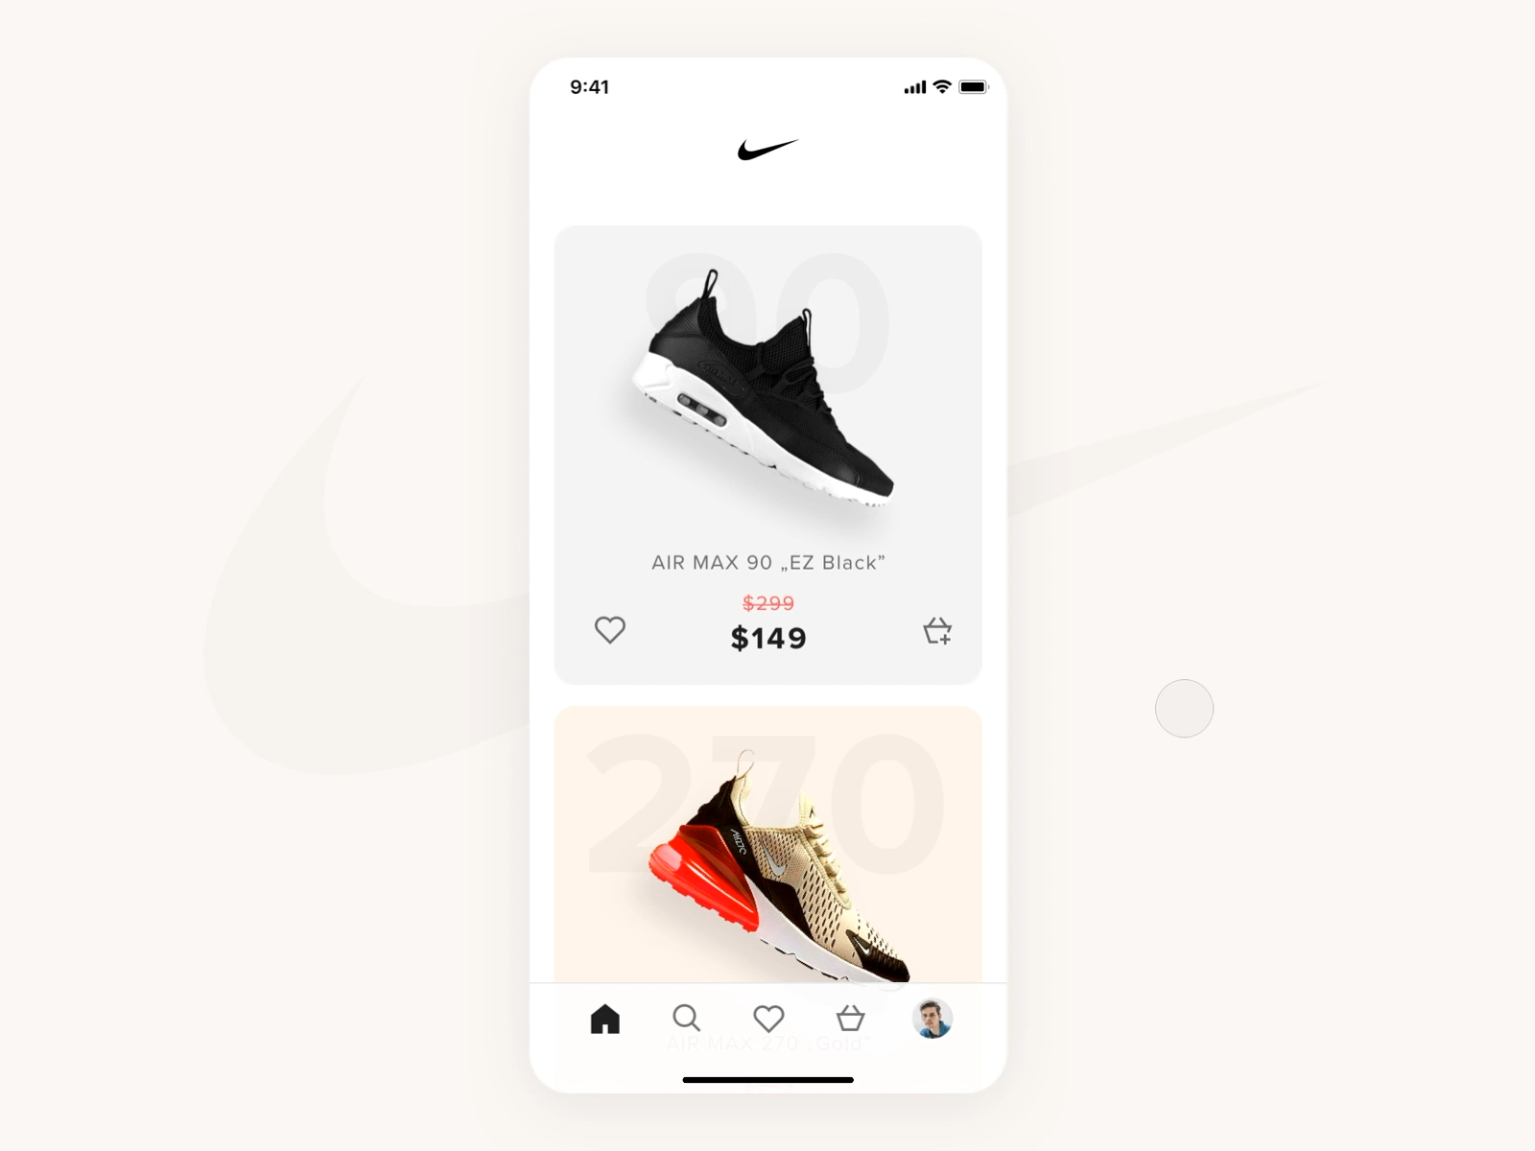
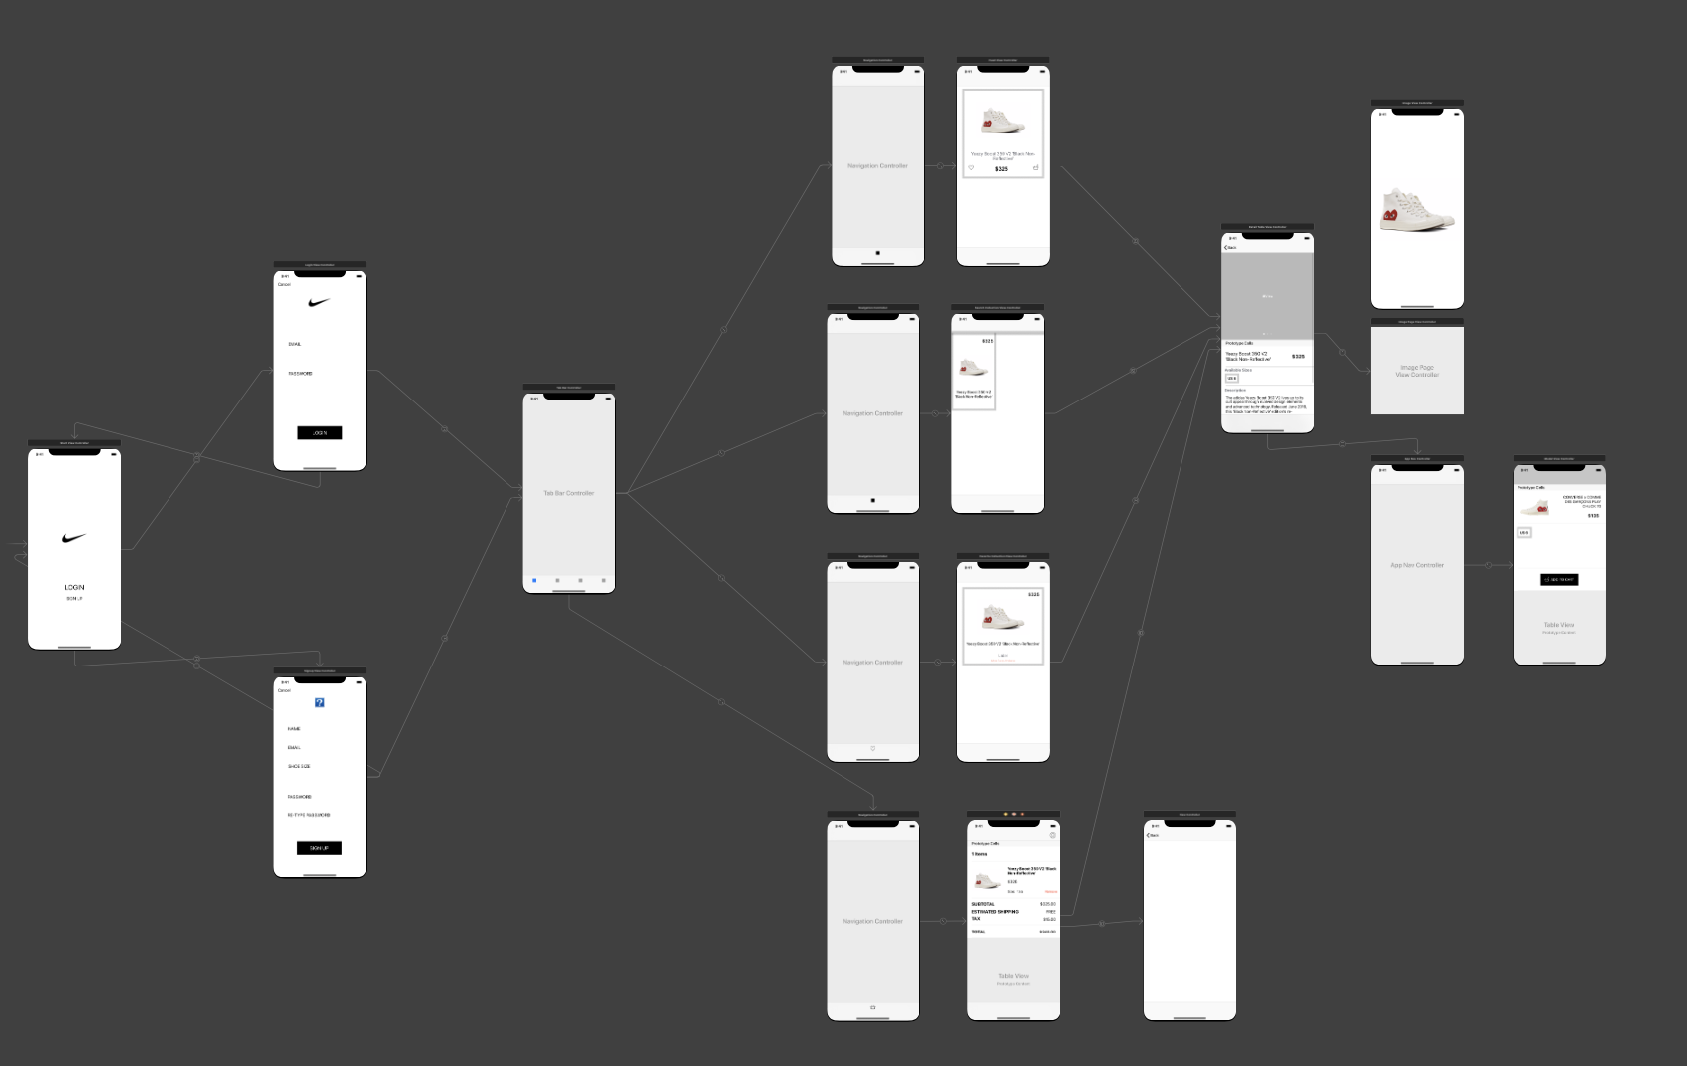
UI/UX Design
Inspired and designed according to the “Nike - Store app concept” posted by Karol Kruszewski for Netguru
via https://dribbble.com

Slide 5
Cloud Firestore
scalable NoSQL cloud database
User Inventory {
Id: String
Email: String
Name: String
Size: String
Likes: [ String ]
Cart: { ShoeId: [String]
}
Shoe Inventory {
id: String
name: String
type: String
price: String
sizes: { Size: Qty }
desc: String
images: [String ]
}

Slide 6
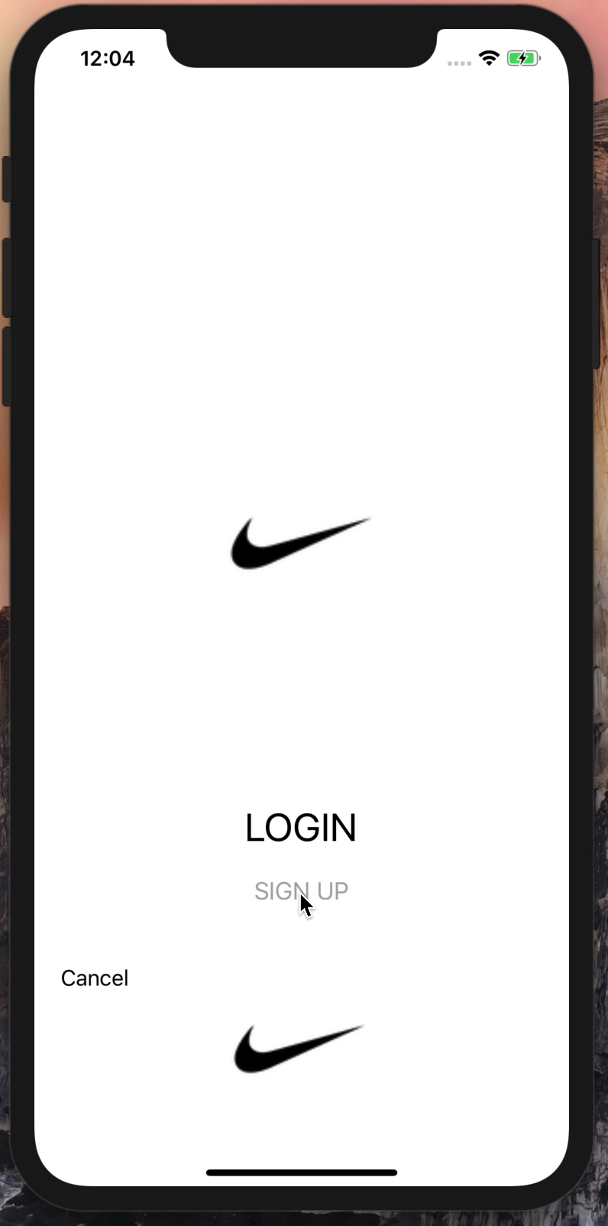
Application Demonstration iPhone XS Max Simulator

